Slide 1
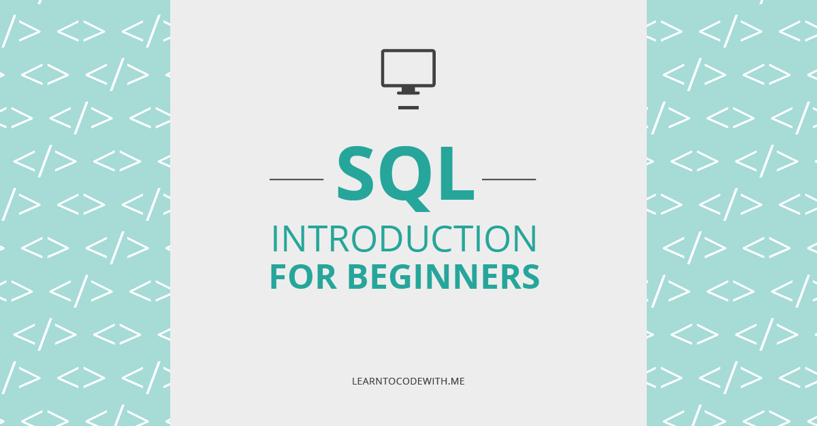

Slide 2
What is a database
Database is a organized collection of data. For example a database of a college would be having a collection of data such as – 1. Personal records of Students 2. Students performance history 3. Teachers data 4. Financial department data etc.
What is a database
Database is a organized collection of data. For example a database of a college would be having a collection of data such as – 1. Personal records of Students 2. Students performance history 3. Teachers data 4. Financial department data etc.

Slide 3
What is a database
Database is a organized collection of data. For example a database of a college would be having a collection of data such as – 1. Personal records of Students 2. Students performance history 3. Teachers data 4. Financial department data etc.
Database Management System (DBMS)
A database management system is a software application which is used for managing different databases. It helps us to create and manage database. With the help of DBMS we take care following tasks – 1. Data Security 2. Data Backup 3. Manages huge amount of data 4. Data export & import 5. Serving multiple concurrent database requests 6. Gives us a way to manage the data using programming languages.

Slide 4
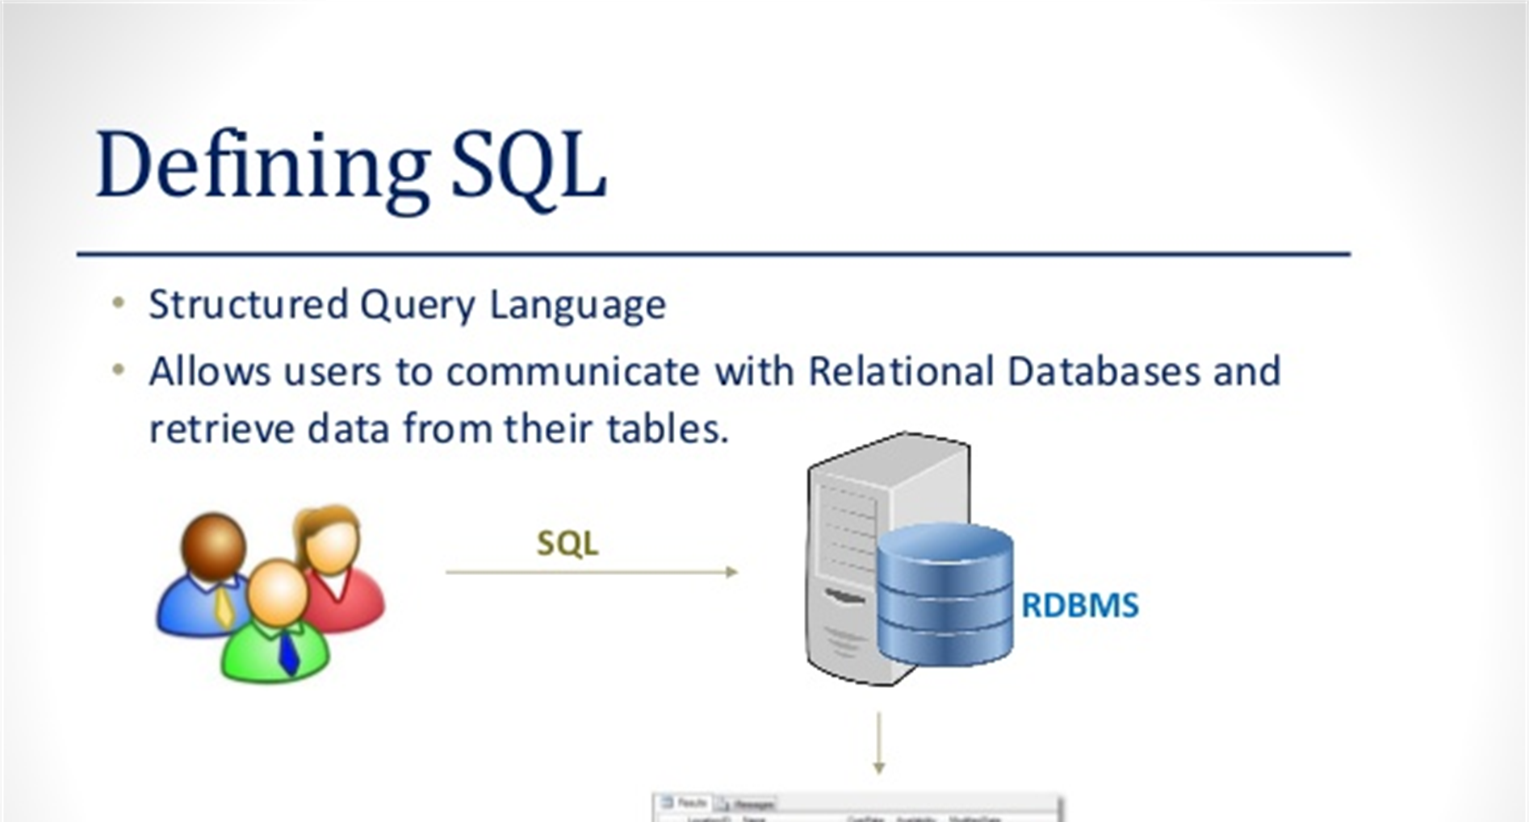
What is a database
Database is a organized collection of data. For example a database of a college would be having a collection of data such as – 1. Personal records of Students 2. Students performance history 3. Teachers data 4. Financial department data etc.

Slide 5
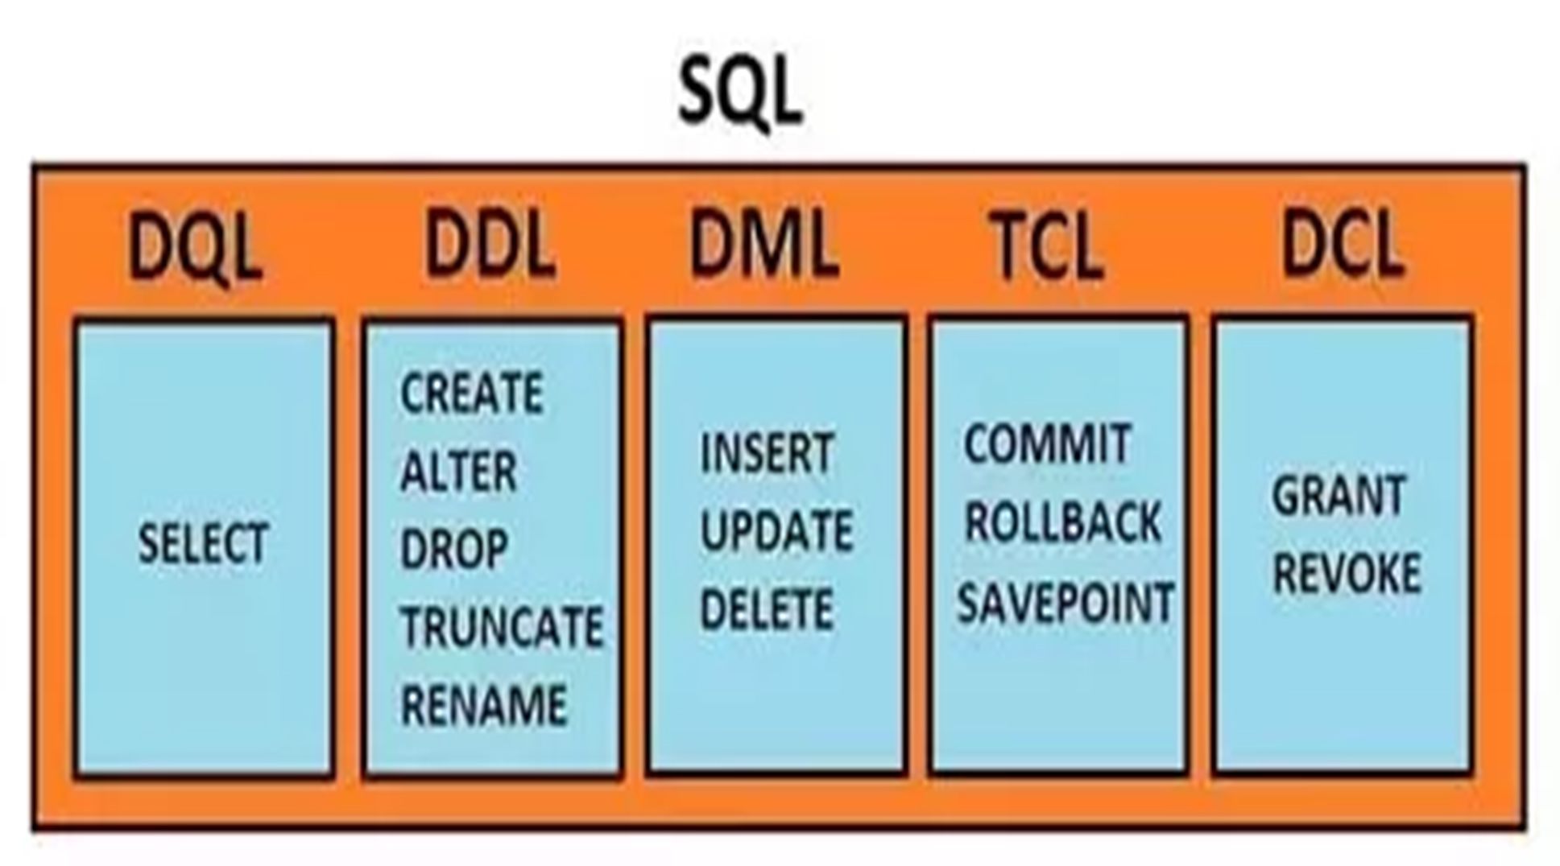
What is a database
Database is a organized collection of data. For example a database of a college would be having a collection of data such as – 1. Personal records of Students 2. Students performance history 3. Teachers data 4. Financial department data etc.

Slide 6
DQL
(DATA QUERY LANGUAGE)

Slide 7
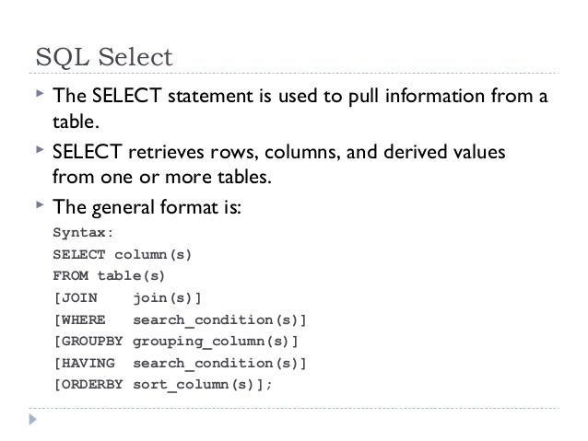

Slide 8
DDL
(DATA DEFINITION LANGUAGE)

Slide 9
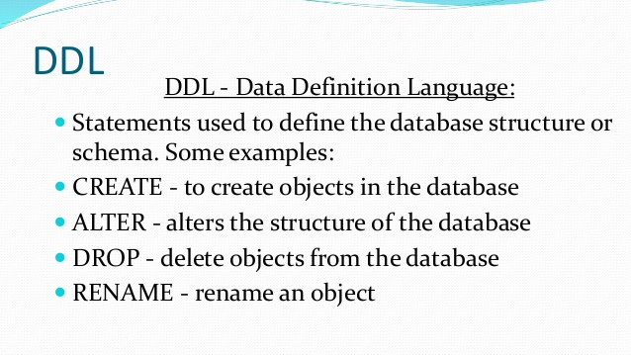

Slide 10
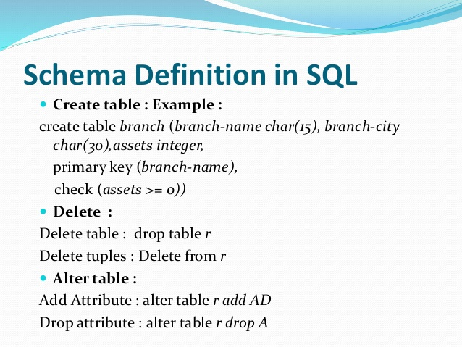

Slide 11
DML
(DATA MANIPULATION LANGUAGE)

Slide 12
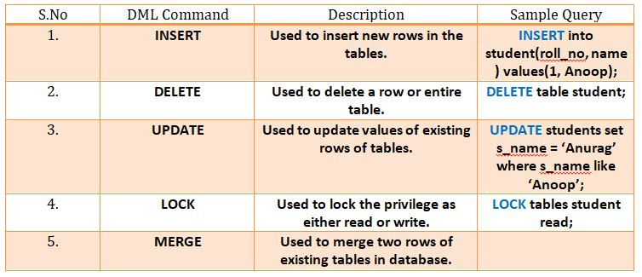

Slide 13
TCL
(TRANSACTION CONTROL LANGUAGE)

Slide 14
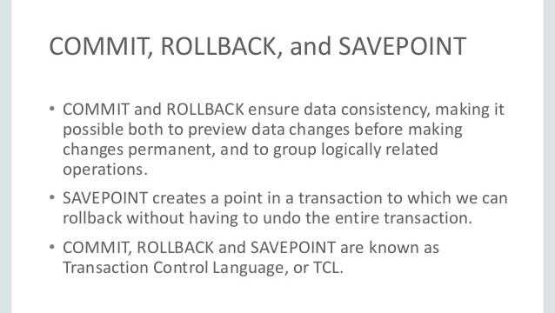

Slide 15
DCL
(DATA CONTROL LANGUAGE)

Slide 16
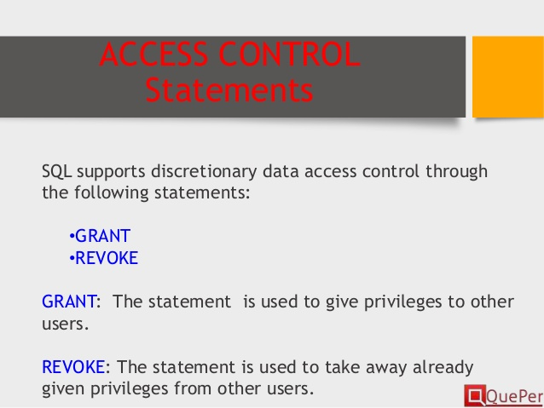

Slide 17
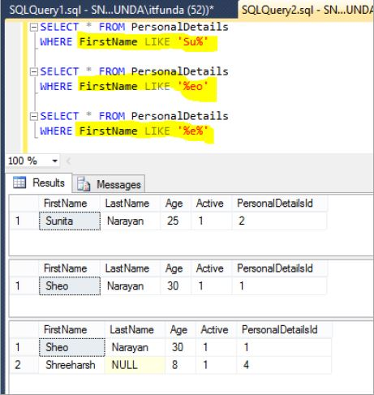

Slide 18
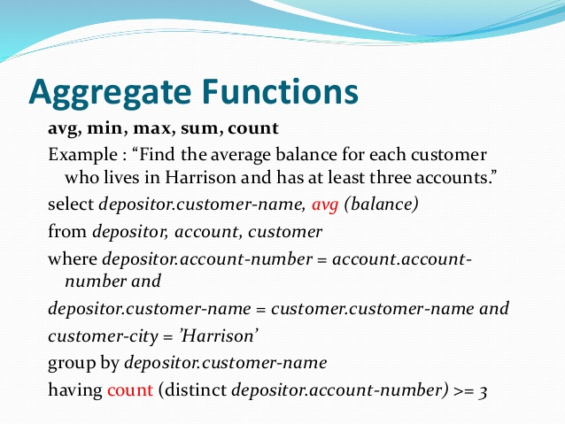

Slide 19
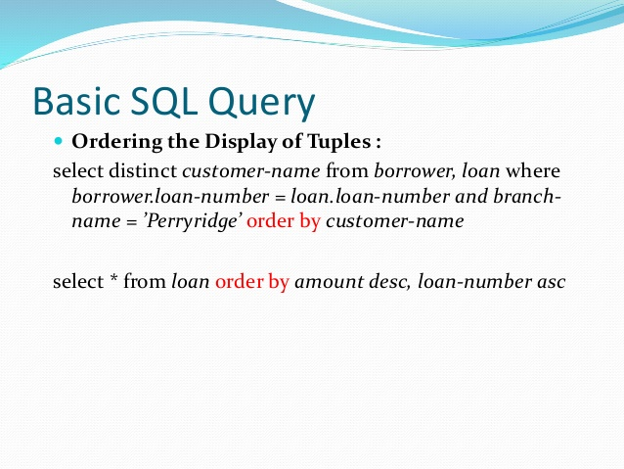

Slide 20
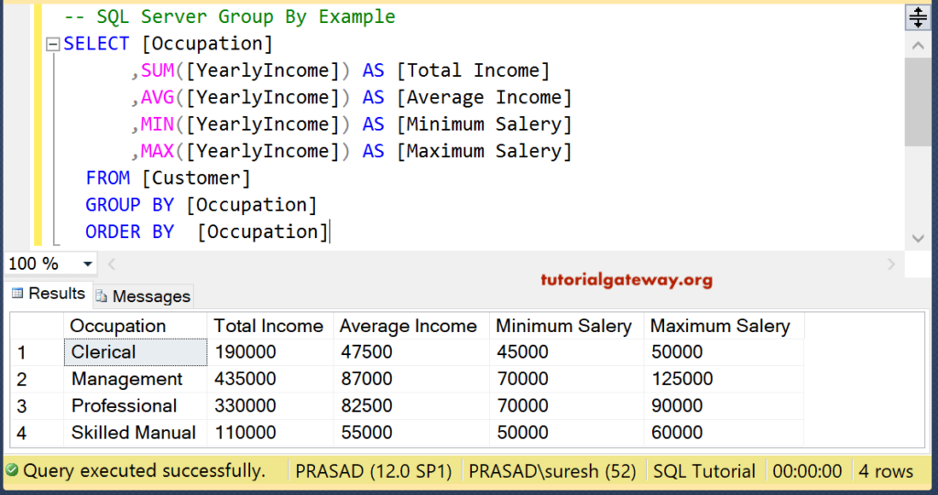

Slide 21
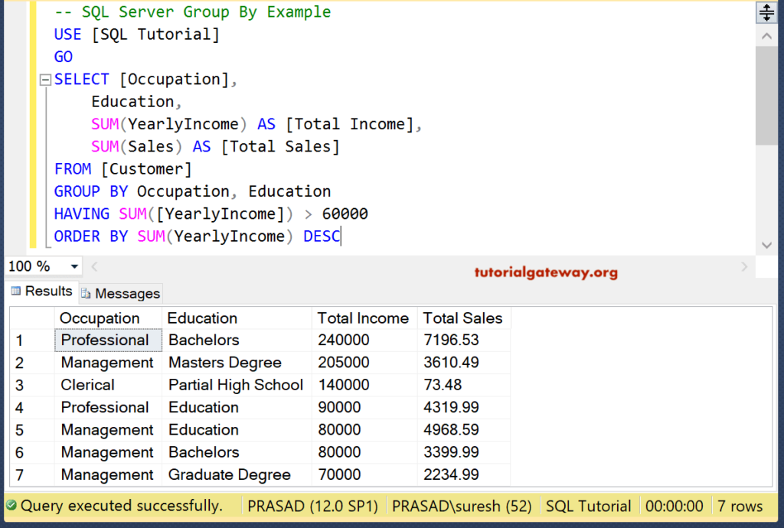

Slide 22
JOINS

Slide 23
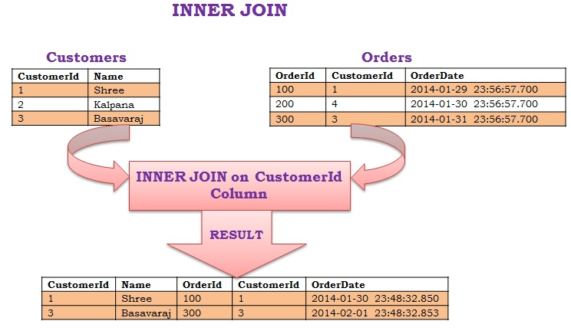

Slide 24
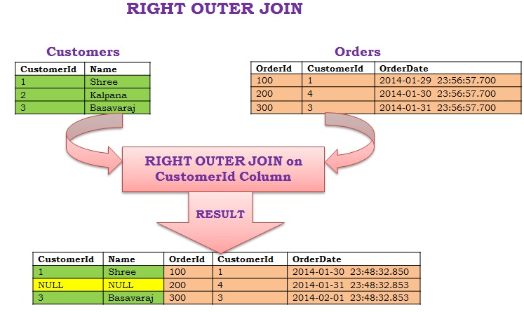

Slide 25
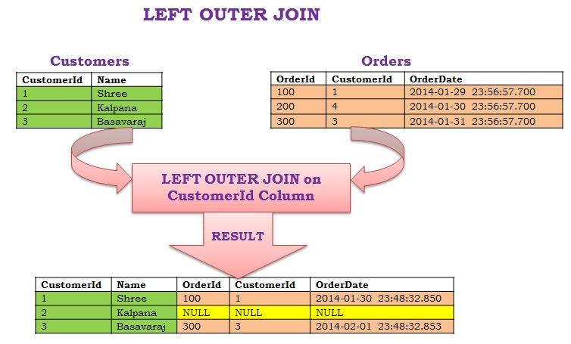

Slide 26
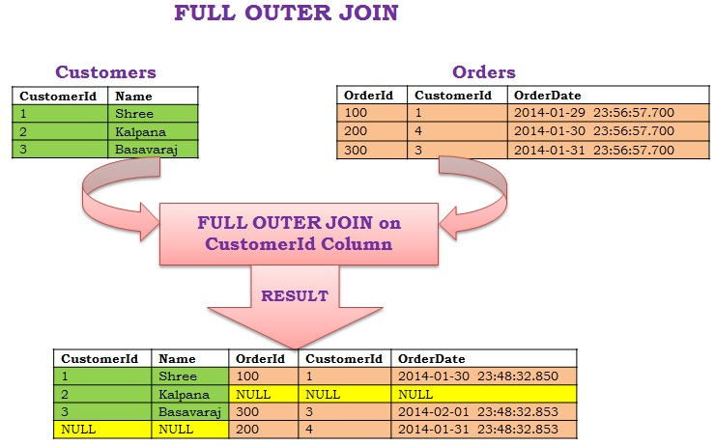

Slide 27
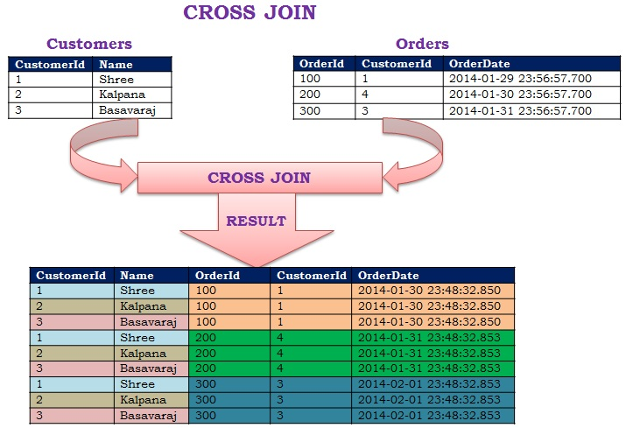

Slide 28
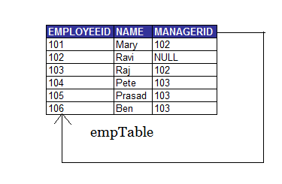
SELF JOIN

Slide 29


Slide 30


